Slide 1




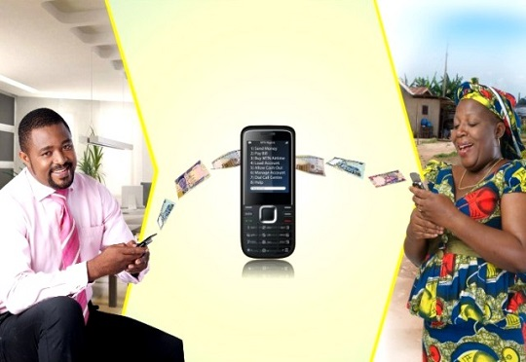

The Role of E-Commerce in Driving Economic Empowerment and Fostering Entrepreneurship in Malawi
Jonathan Pinifolo, PhD
Chief Operating Officer, CBC Digital Financial Inclusion Programme

Slide 2

In order to thrive in the 21st century, you have to be a savvy citizen of the digital economy or risk being left behind— Leila Janah

Slide 3

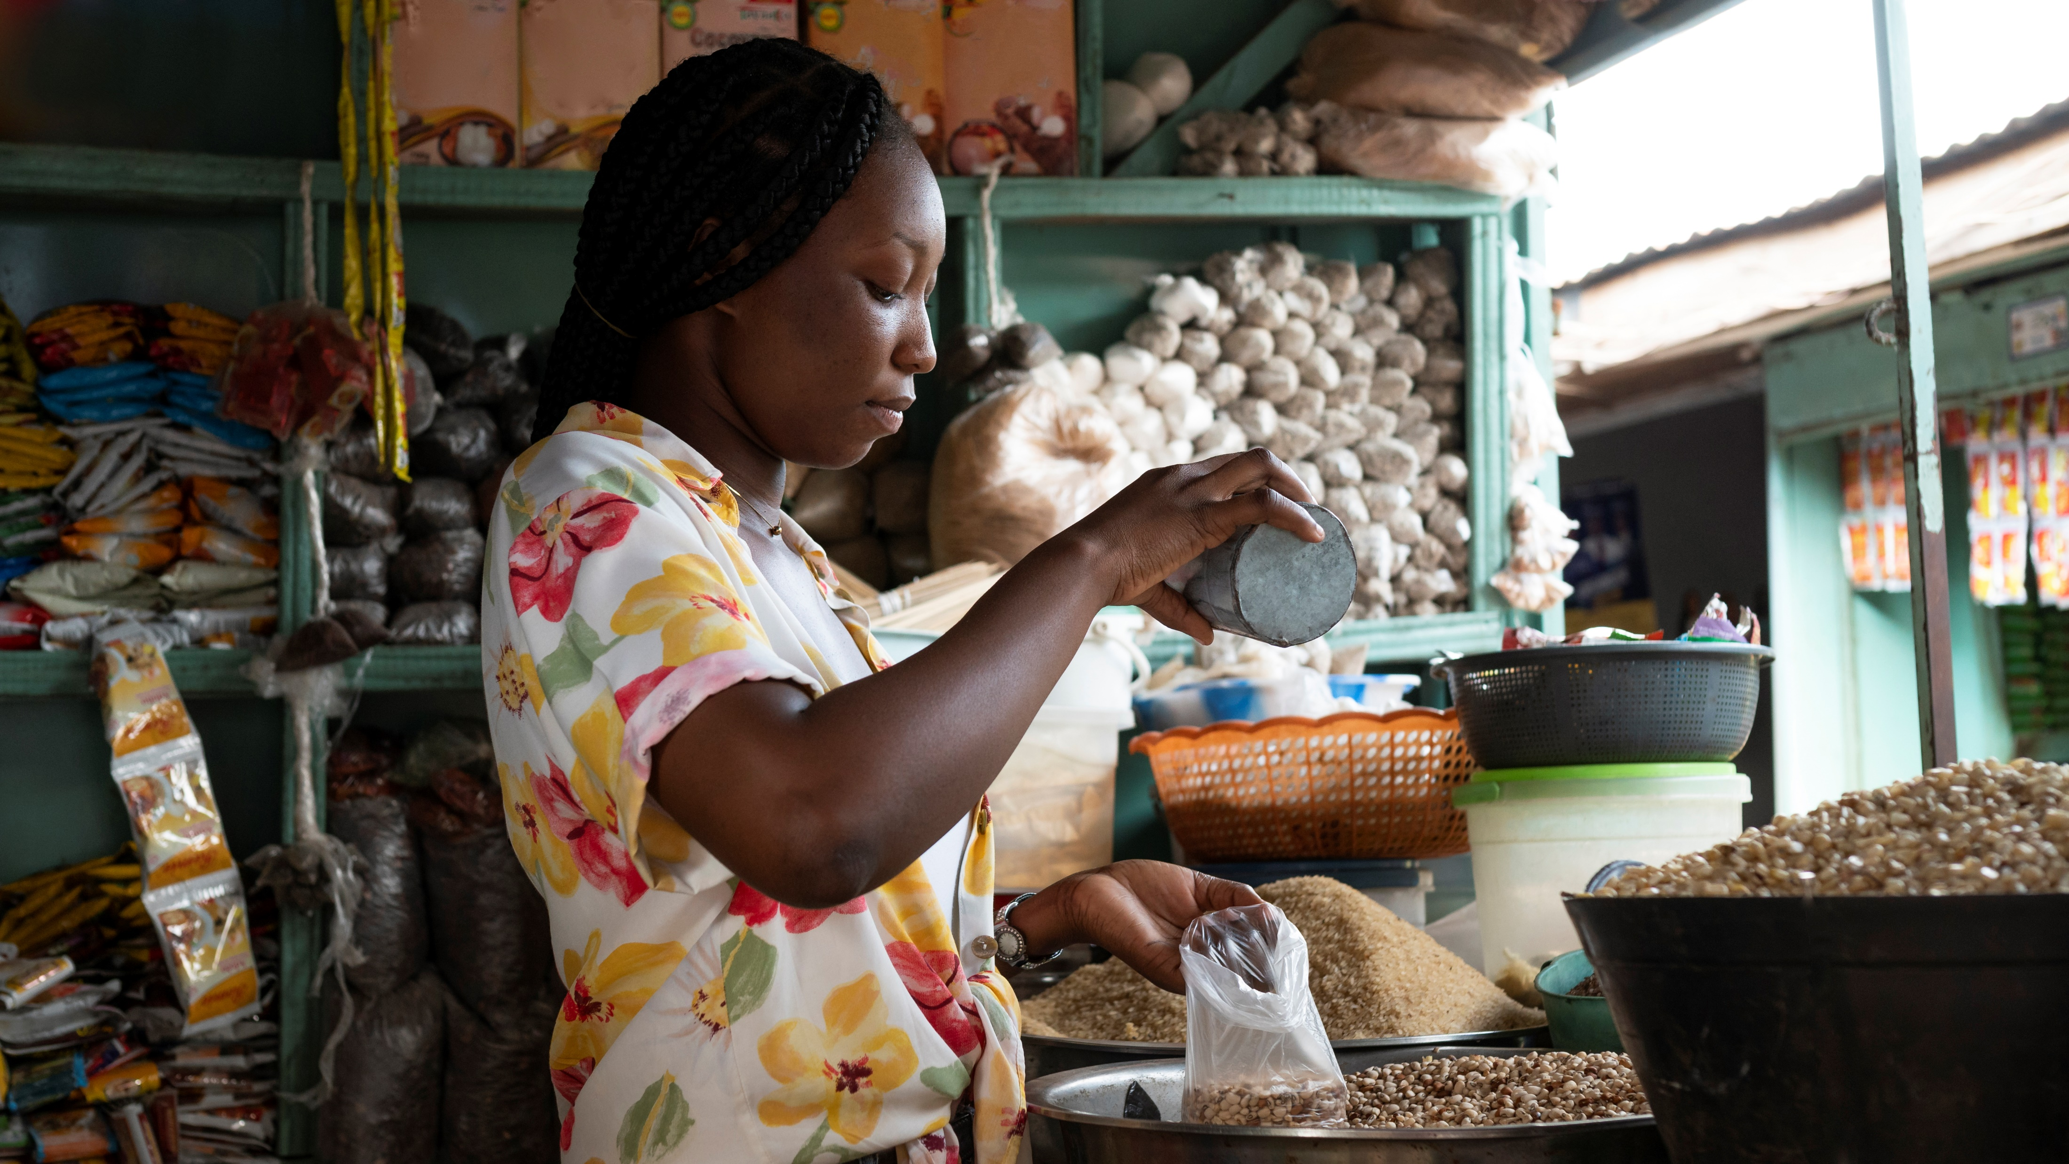
ENTERPRISES: THE POWERHOUSES OF AFRICA’S ECONOMY
According WTO, “e-commerce may be defined as the production, advertising, sale and distribution of products via telecommunication networks”
Africa leads the world in entrepreneurship, with MSMEs driving 80% to 90% of the continent’s job market.
In Sub-Saharan Africa, MSMEs account for about 95% of all registered businesses and contribute to approximately 50% of the total GDP.

Slide 4

ENTERPRISES: THE POWERHOUSES OF AFRICA’S ECONOMY
In Malawi, according to the 2019 FinScope MSME Survey, there nearly are 1.6 million MSMEs in the country, employing about 1.8 million people in total.
74% are micro enterprises, 23% small enterprises, and only 3% medium enterprises
MSMEs contribute about 40% to the GDP and 24% to employment in Malawi

Slide 5

THE CASE FOR E-COMMERCE
Significant number of countries globally, shifting to e-commerce, especially after COVID-19. Nevertheless, African MSMEs have been slower to adapt.
Malawi’s e-commerce landscape lags behind, 141 out of 152 countries on the UNCTAD E-commerce Index for digital economy development (2019).
Unlike Europe, Africa still does not have an effective continental or regional retail payments platform(s) to facilitate e-commerce

Slide 6
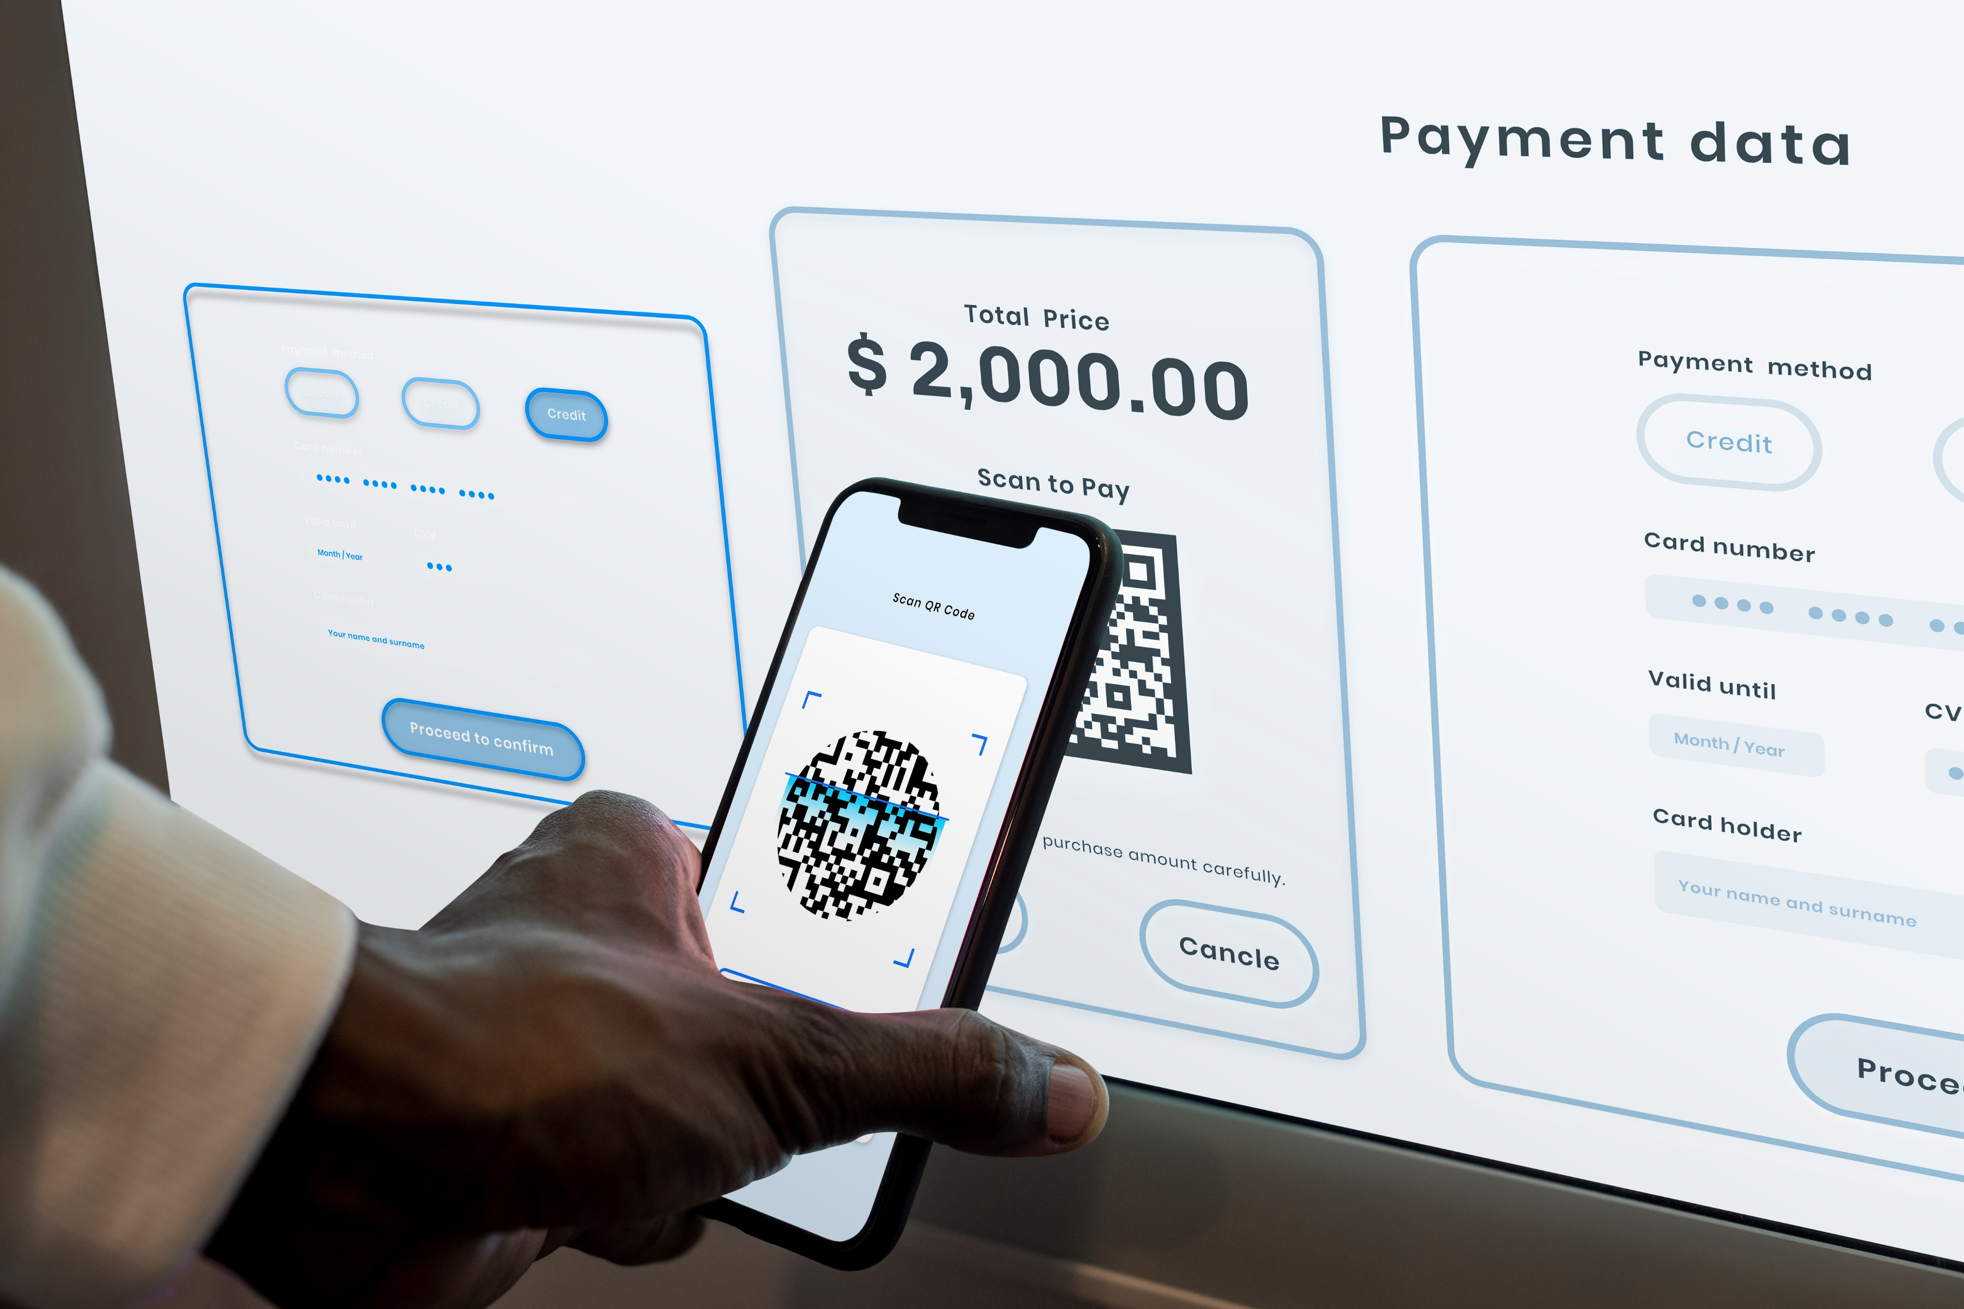
THE CASE FOR E-COMMERCE
Implementation of regional payments platforms like COMESA Digital Retail Payments Scheme to accelerate e-commerce is critical.
Evolving landscape of internet penetration and mobile adoption rates is a golden opportunity for African businesses, Malawi inclusive, to embrace e-commerce and unlock its potential.
Failure to embrace e-commerce by entrepreneurs, especially post-COVID, means missing out on unparalleled access to a global market, and the opportunity to expand their reach beyond local boundaries.

Slide 7


COMESA DIGITAL RETAIL PAYMENTS SCHEME
VALUE PROPOSITION
Local currency approach
Affordability
Instant and inclusive payments
Capacity building
Wide geographical reach
Interoperability
Market intelligence access
Security
Value added services
Access to finance

Slide 8

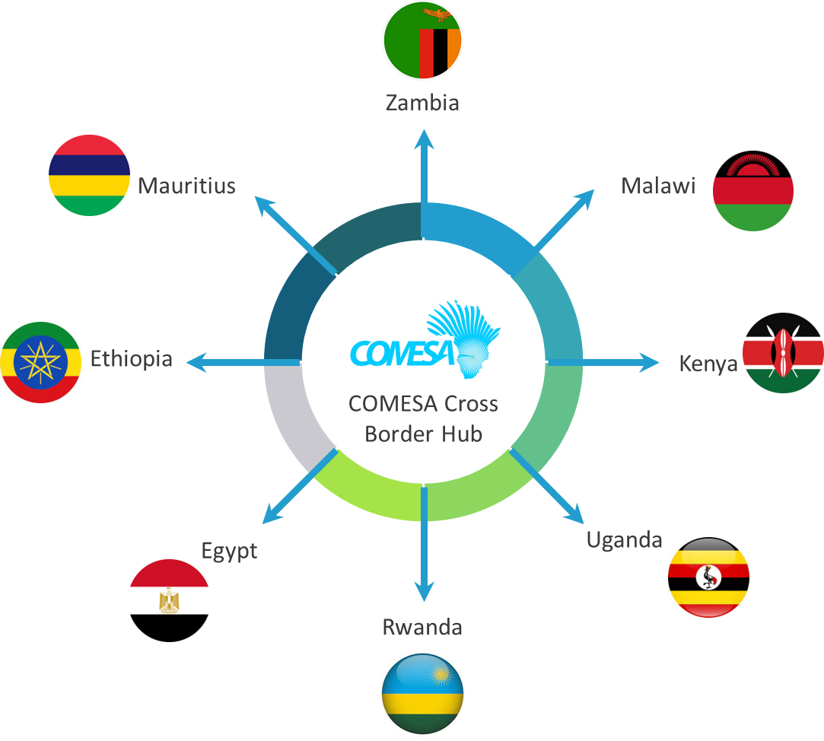








Broader Vision
COMESA Regional Cross-border Instant Payment Hub
Expected Outcome
Enhanced Financial Inclusion
Participation of MSMEs in formal regional trade
Increased volumes of cross border transactions
Increased visibility of African products within regional markets
Directly respond to the intra-trade deficit in the region
COMESA Business Council
(Sponsor)
COMESA Clearing House
(Clearing)
Bank of Mauritius
Settlement Institution
8

Slide 9

ECONOMIC BENEFITS OF E-COMMERCE FOR ENTREPRENEURS
Eliminates expenses associated with physical storefronts and streamlines inventory management, improving profitability for entrepreneurs
E-commerce platforms offer accessible entry points for entrepreneurs with minimal capital investment, fostering innovation and empowering individuals to compete effectively in the marketplace.

Slide 10


CHALLENGES FACED BY ENTREPRENEURS
Lack of political will i.e. no deliberate policies
Lack of Market Intelligence and updated information
Lack of supportive Infrastructure
Lack of exposure to necessary skills
High cost of Transactions
High Taxation

Slide 11


“Never let a good crisis, go to waste”-There are always learnings’-Sir Winstone Churchill
The government’s National ICT Policy aims to enhance ICT infrastructure, including extending fibre-optic networks, launching 5G capabilities, and establishing a universal service fund.
The Electronic Transactions and Cyber Security Act of 2016 lays the foundation for e-commerce development in Malawi, providing regulations and guidelines for electronic transactions and cyber security.

Slide 12





Slide 13




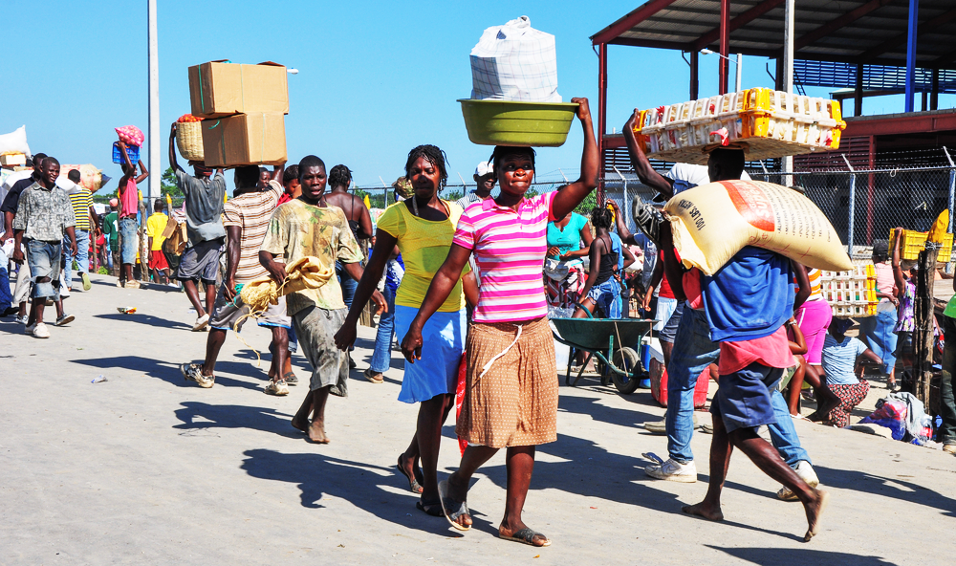

Slide 14






COMESA Business Council, COMESA Building, Right Wing, 2nd Floor, Ben Bella Road,
P.O. Box 30051, Lusaka, Zambia
info@comesabusinesscouncil.org
+260 761 228 754 | +260 211 229725/32
@comesabusinesscouncil
@COMESABusiness
@COMESA Business Council
@comesa_business_council_1

