Slide 1
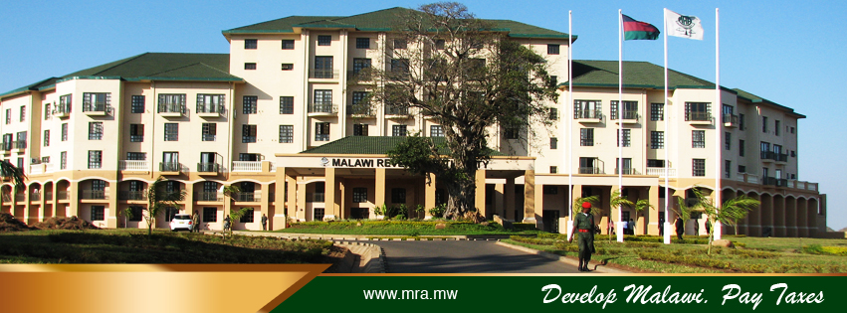
EMBRACING DIGITAL TRANSFORMATION: Revolutionalising Tax Administration for Economic Empowerment in Malawi
Presenter : John Biziwick – Commissioner General - MRA

Slide 2
Contents
Introduction
The Power of Digital Transformation in the context of a Revenue Administration
Understanding Current Tax Administration Landscape in Malawi
The Malawi Domestic Revenue Mobilisation Strategy Principles
The Role of Malawi Revenue Authority (MRA) in Economic Empowerment
The Need for an Efficient MRA
Challenges faced by the Malawi Tax System
The need for Tax Compliance
How can Digital Transformation revolutionise the Malawi Revenue Authority and lead to Economic Empowerment
Ways in Which Digital Technologies have Revolutionalised MRA
Sampling the MRA Digital Journey So far
Achievement after digitising filing, Declaration, Payment and Compliance processes
The Future of Revenue Administration
Key Considerations

Slide 3






1. Introduction
1
2
3
4
5
A proactive approach to harnessing the power of digital technologies for sustainable economic empowerment is a necessity for the MRA.
In today's rapidly evolving digital age, revenue administrations across the globe are facing a critical crossroads.
Traditional, paper-based systems are proving increasingly inefficient and susceptible to errors.
To ensure sustainable economic development and empower citizens, effective domestic revenue mobilisation is essential
Digital technologies can unlock economic empowerment through effective revenue collection and fiscal management.

Slide 4




2. The power of digital Transformation in the context of a Revenue Administration
Convenience
Efficiency
Technologies
By embracing these technologies, businesses can streamline operations, unlock new opportunities and create a more competitive landscape
This fosters innovation, boosts efficiency, and ultimately leads to economic growth
From cloud computing enabling remote work to Artificial Inteligence (AI) streamlining data analysis, the impact is undeniable

Slide 5



3. Understanding the current Tax Administration landscape in Malawi
Domestic Revenue Mobilisation Strategy
Why DRMS
DRMS VISION
The Strategy aims to :
Provide stability and transparency in revenue policy making process
seeks to ensure that Government gradually reduces its reliance on external and domestic debt
The Vision of this Strategy is :
“Optimal domestic revenue for improved public service delivery and quality of life for all Malawians”
The Malawi Government through the Ministry of Finance formulated the first ever Domestic Revenue Mobilisation Strategy (DRMS) in 2021

Slide 6

4. The Domestic Revenue Mobilisation Strategy : The Guiding principles for discussion
2
Efficiency & Economic Growth
Compliance
1
Government will seek to ensure that tax policies facilitate efficiency and economic growth.
Government will endeavor to structure its tax laws in such a manner that promotes tax compliance.
Government will endeavor to keep to the minimum the cost of revenue collection.
Government will ensure automation of non-tax revenue collection and strengthening of its monitoring systems
4
Low Cost
Automation
3

Slide 7
5. The Role of Malawi Revenue Authority (MRA) in Economic Empowerment :
1
MRA forms the backbone of government finances, facilitating the collection of taxes and other revenues necessary for public expenditure.
Effective revenue collection ensures the availability of funds for infrastructure development & social welfare programs.
2
Transparent and efficient tax systems foster investor confidence, stimulate entrepreneurship, and create an enabling environment for business expansion and job creation.
By leveraging taxation as a tool for redistributive justice and resource mobilization, MRA contributes to broader gains in governance quality and socioeconomic development.
3
4
Notes:
Beyond mere revenue generation, effective revenue collection ensures the availability of funds for infrastructure development, social welfare programs, by establishing a social contract between citizens and the government, thereby promoting accountability and transparency.

Slide 8

6. THE NEED FOR AN EFFICIENT MRA
Malawi needs to increase domestic revenues for supporting its development goals as set out in the country’s long term national development plans.
Substantially higher expenditures are required on infrastructure, education, healthcare, energy, agriculture, tourism and other priorities, to raise and sustain a level of economic growth to uplift people out of poverty and improve the well-being of all Malawians

Slide 9




7. Challenges Faced by The Malawi Tax Systems
1
2
3
4
Manual processes leading to inefficiencies and errors
.
Tax evasion and avoidance due to lack of transparency.
Insufficient data for effective policy making and revenue forecasting
Large informal sector resulting in many business not captured in the tax net

Slide 10
8. THE NEED FOR TAX COMPLIANCE:
What is Tax Compliance :
the fulfilment of tax obligations by businesses and individuals.
1
Four main categories of taxpayer obligations prescribed in the Tax Laws are:
Registration in the tax system
Timely filing of declarations
Payment of tax liabilities on time
Complete and accurate reporting of information in tax declarations
For many aspects of tax compliance, the effective operation of the tax system by the tax authorities influences taxpayers’ compliance behavior
The Tax Authority needs to be continuously efficient in administering the tax system in order to curtail tax evasion
2
3
Notes:
Beyond mere revenue generation, effective revenue collection ensures the availability of funds for infrastructure development, social welfare programs, by establishing a social contract between citizens and the government, thereby promoting accountability and transparency.

Slide 11
9. How can Digital Transformation Revolutionise MRA and lead Economic Empowerment
1
2
3
4
New Opportunities in the Economy
Online Platforms
Increased Productivity
Job Creation
As the digital economy flourishes, new business models and transactions emerge creating new opportunities for entrepreneurs and businesses which leads to formalization of the informal sector
Connect businesses with a wider range of customers and markets, eliminating barriers of physical presence but impacting on a bigger community
Digital tools help businesses to improve efficiency and productivity increasing their revenues
Digital skills can make individuals more employable and competitive in the job market
Notes:
Digital transformation has the potential to level the playing field for entrepreneurs and businesses in developing countries. Online platforms can help businesses to reach customers all over the world, regardless of their location. Digital tools can help businesses to automate tasks, improve efficiency, and reduce costs. And digital skills can make individuals more employable and competitive in the global job market.

Slide 12
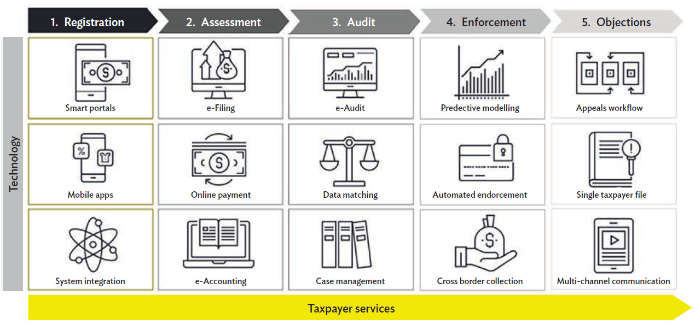
Focus Areas of The MRA Digital Transformation Agenda

Slide 13




10. Digital technologies have revolutionised MRA in several ways :
Efficient Data Management
Automation of Processes:
Digitalisation has enabled the efficient collection, storage, and analysis of tax data. This will result into gaining valuable insights into taxpayer behavior, identify trends, and detect non-compliance more effectively.
Manual tax processes are prone to errors, delays, and inefficiencies. The automation of processes has not only reduced the administrative burden but also improved the overall efficiency and accuracy,
Enhanced Compliance
Stimulus for Economic Growth
Digitalisation has facilitated real-time monitoring and tracking of taxpayer, making it easier to identify discrepancies and instances of tax evasion.
By improving tax compliance and revenue collection through digitalisation has provide government with resources to invest in key areas such as infrastructure, education, and healthcare. This creates a conducive environment for economic growth, job creation, and poverty reduction.

Slide 14
11. Sampling The MRA Digital Journey so far…
e- filing & Declaration
ePayments
Online tax return submission and customs declaration now almost ubiquitous, offering a convenient and efficient -filing and declaration process enabling greater participation in the formal economy
Integration of banking systems with the MRA payment platform for tax and trade liabilities reducing cost of compliance giving more time to taxpayers to do business
Interfaces with other institutions
Outreach programs leveraging the power of digitilisation, MRA has enhanced outreach, accessibility to information for compliance to tax obligations
Taxpayer Portals
Chat bots and Mobile Applications
Secure online portals offer a one-stop shop for taxpayers to access tax information, file returns, make payments, and track their tax status
User-friendly mobile apps allow taxpayers to manage their taxes on the go, further enhancing convenience and accessibility.

Slide 15
12. Achievements after Digitalising Filing, Declaration, Payment and Compliance
2
simplified transactions and made it easy for taxpayers & Importers
Pay taxes anytime, anywhere, on any device.
  Effective combat against tax evasion reduced bureaucratic inefficiencies in some processes
1
reduced cost of compliance and administration
adaptation to evolving taxpayer needs and emerging challenges
4
  Widening the tax net
3

Slide 16


13. The Future of MRA:
2
Emerging Technologies
Personalised Services
1
AI, Blockchain and Big Data hold immense potential for further streamlining tax administration.
Tailored tax information and guidance based on individual taxpayer profiles
Proactive identification of potential tax issues and customised solutions – prefilled returns
Ongoing innovation to deliver a seamless and user-friendly experience.
4
Predictive Analysis
Continuous Improvement
3

Slide 17




14. Key Considerations
Digital Divide
Cybersecurity
Data Privacy
Not all have access to reliable internet or digital devices. Strategies are needed to ensure inclusivity.
- Internet Penetration in Malawi - 24.4 % (2023)
Affects mainly rural areas (access and use)
- Data must fall initiatives
Robust security measures (at both ends) are crucial to protect data and prevent cyberattacks.
National ICT Policy
National Cybersecurity Strategy
Electronic Transactions and Cybersecurity Act of 2016
Clear data privacy policies and regulations are essential to build trust with taxpayers.
Malawi Data Protection ACT of 2023
Accuracy, Storage limitation, Integrity and Confidentiality
Change Management
Transitioning to digital services requires effective communication and support for intended users and administration staff.
Capacity building & massive stakeholder engagement
Change Management Strategy
Culture Change Initiative
Significant investment in digital infrastructure
People : ICT Professional Ethics
Notes:
Capacity building & massive stakeholder engagement

Slide 18

Zikomo
Kwambiri

